Slide 1




DIGITAL LITERACY
SKILLS
ADVANCED USERS

Slide 2
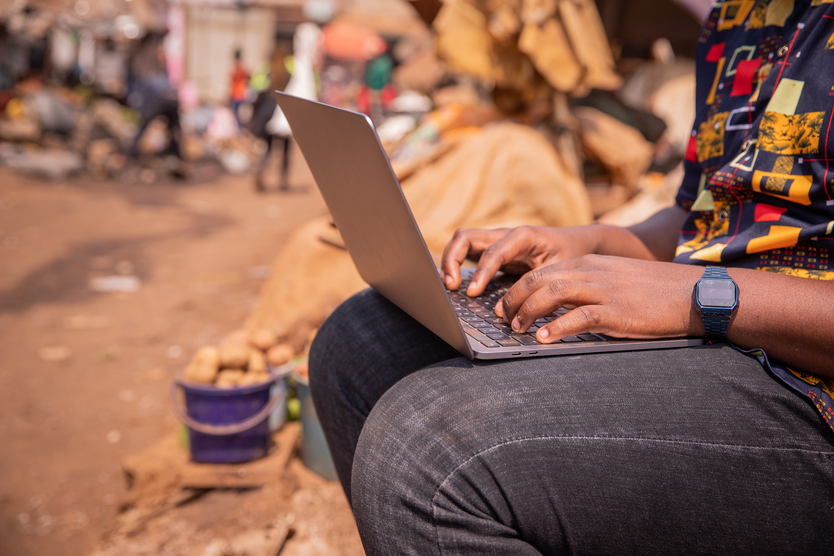
Module 3
Communication
and collaboration

Slide 3

3
Unit 3: Engaging in citizenship through digital technologies

Slide 4
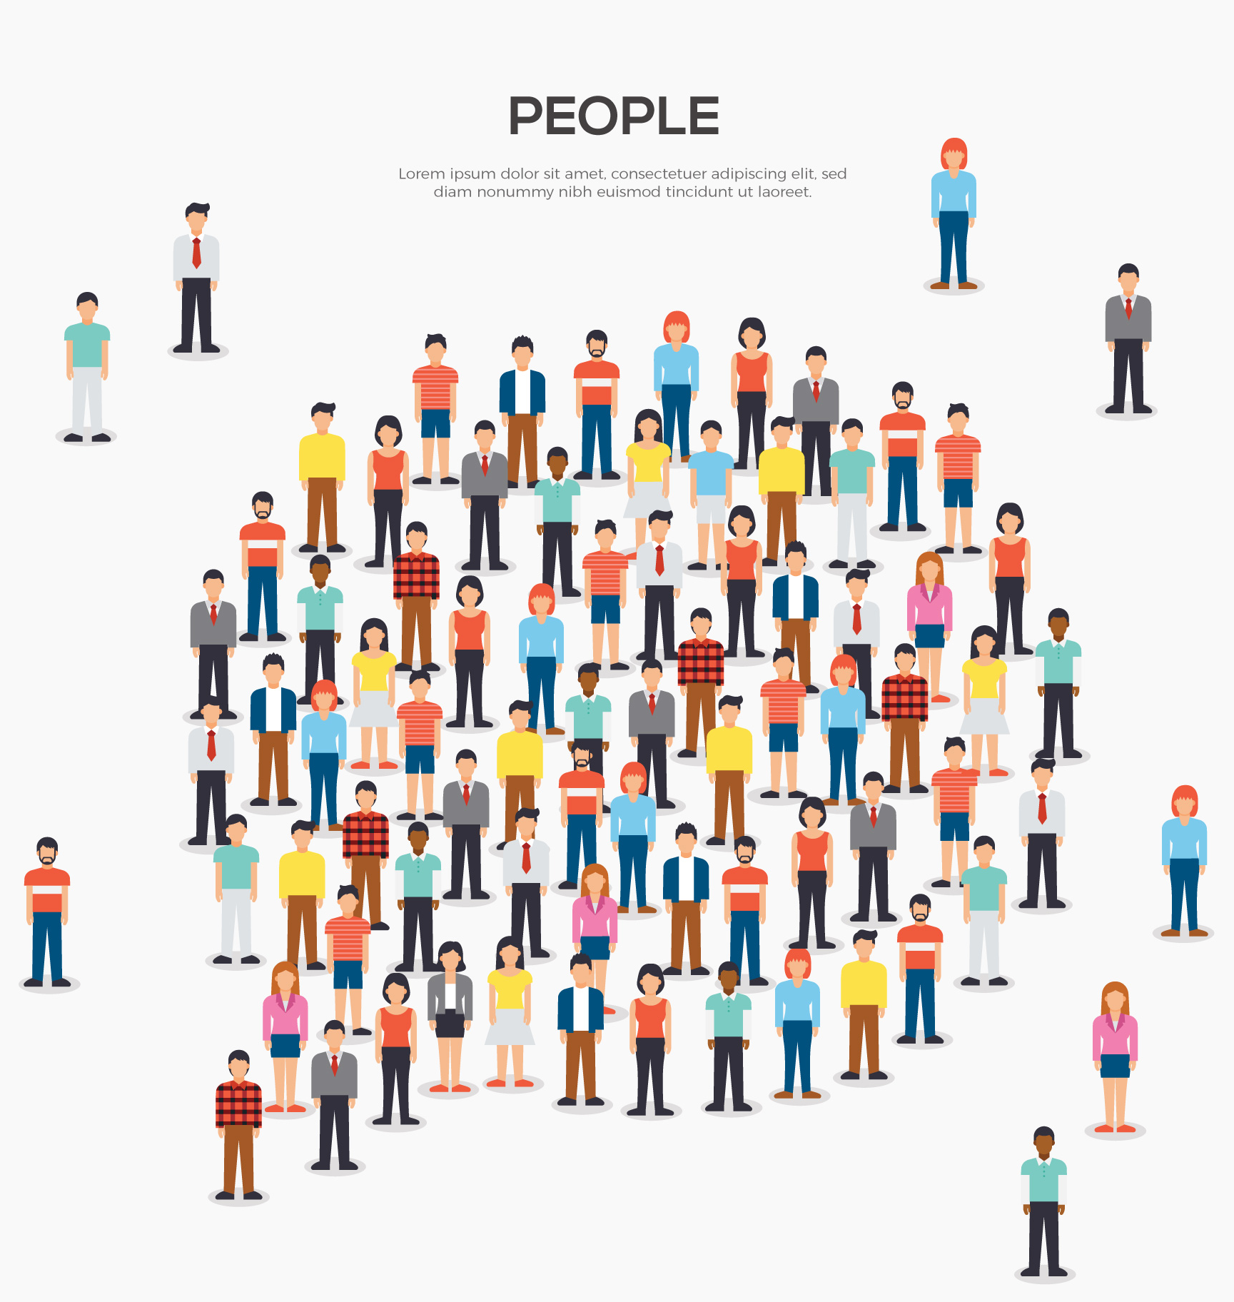
Basic concepts of digital citizenship
E-Safety: Includes internet privacy and how behaviour can add to healthy interactions.
Reputation: How we are perceived online.
Relationships: Using technology to interact with others.
Ethics: How to act in an ethical way online.

Slide 5
Digital citizenship
A good citizen |  | A good digital citizen
Advocates for equal human rights |  | Advocates for equal digital rights for all
Treats others with respect |  | Seeks to understand all perspectives
Does not steal or damage others’ property |  | Respects digital privacy, intellectual property, and other rights of people online
Communicates clearly respectfully and with empathy |  | Communicates and acts with empathy for others’ humanity via digital channels
Speaks honestly and does not repeat unsubstantiated rumours |  | Applies critical thinking to all online sources, including fake news
Protects self and others from harm |  | Is mindful of physical, emotional, and mental health while using digital tools.
Projects a positive self-image |  | Understands the permanence of the digital world and proactively manages their digital identity

Slide 6
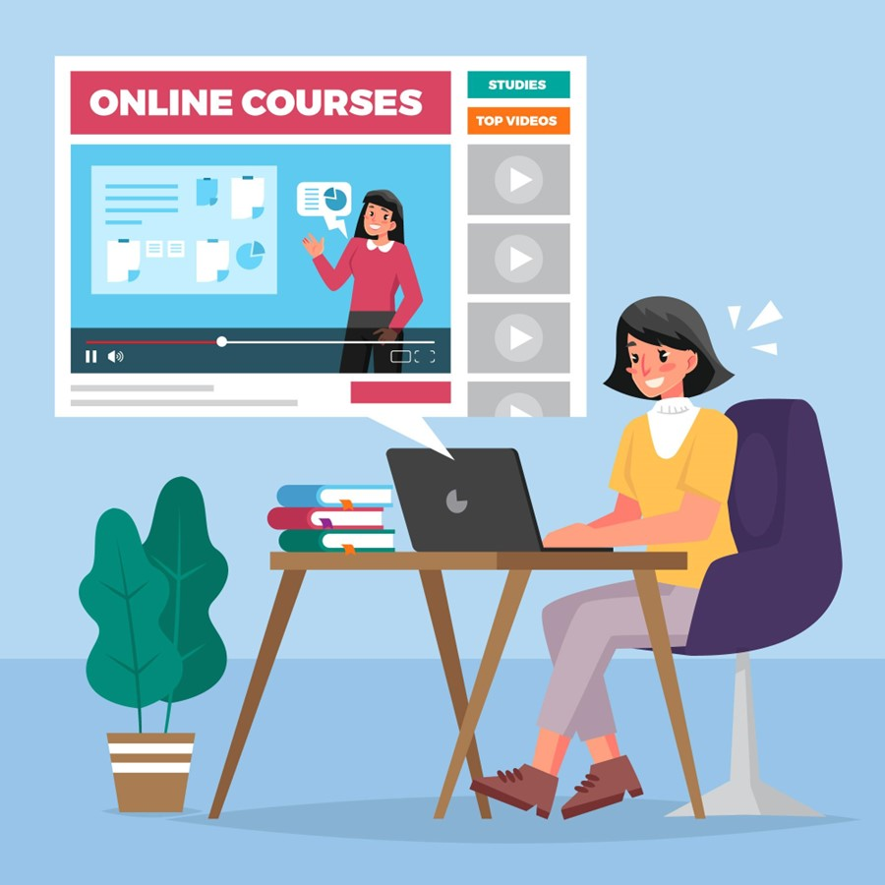
Online training and eLearning
Online teaching and training services take many forms.
Some advertise the services they offer at their premises, whereas others offer online training and e-learning.

Slide 7
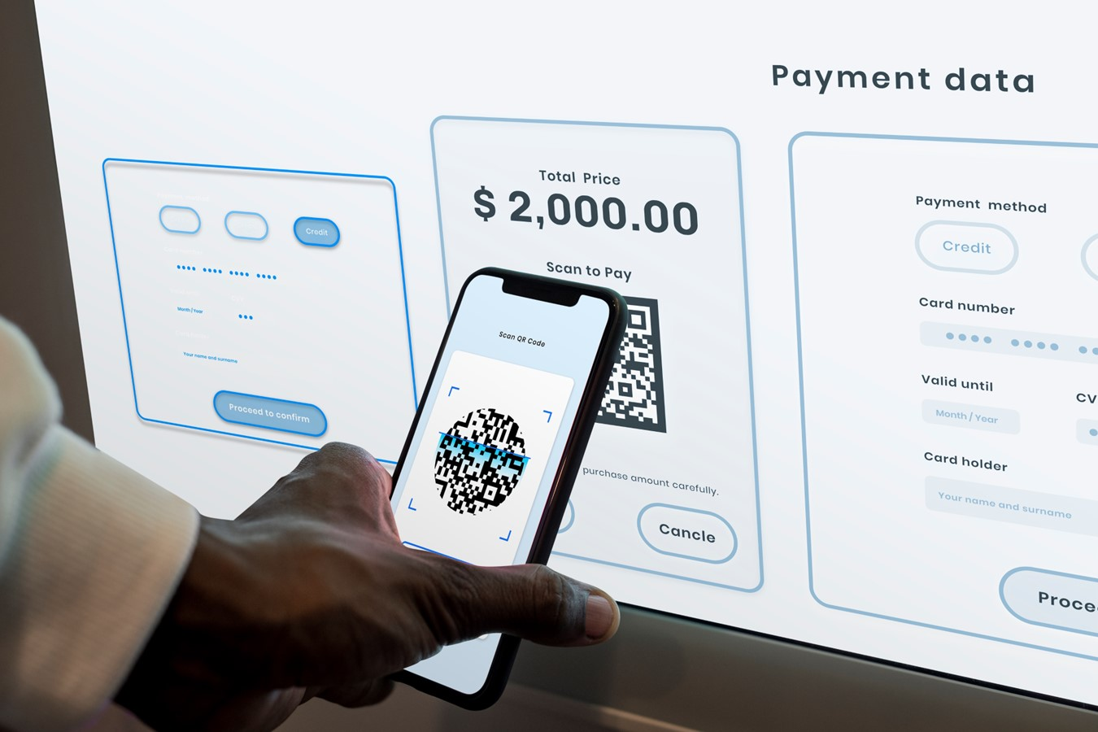
Features of online services
Online public services
Online banking
Online shopping

Slide 8
Guidelines for interacting with online services
1
2
3
Ensure that the site is safe
Ensure that the payment methods on the site are authentic
Ensure that you find out about the online services before you register.

Slide 9
Skills to practice
Actively participate in online spaces and digital platforms (e.g., Twitter) and use several online services (e.g., public services, digital finance, online shopping).
Use a tablet and download the Twitter app. Create an account.
Create a least three messages that you can post as a thread, respond to any comments you may receive.
Use the internet to research how to open a banking account in your area. Note that you will most likely need to go to the bank to open an account, but your research will tell you:
which is the best bank to join
what type of account is best suited for your needs
what are the requirements for opening a bank account.
Use the internet to research if there are any online shopping apps available in your area. Make a list of the requirements and costs linked to using the app, including delivery fees.

Slide 10
All back covers should include
contact information of the section
producing the work.
© United Nations Children’s Fund (UNICEF) [month and year of publication]

